Slide 1

Code Academy: CoolTShirt Touch Attribution
Learn SQL from Scratch
Nicole Scott
7/6/2018

Slide 2
Table of Contents
1. Get Familiar with the Company.
1.1. How many campaigns and sources does CoolTShirts use and how are they related?
1.2. What pages are on their website?
2. What is the user journey?
2.1. How many first touches is each campaign responsible for?
2.2. How many last touches is each campaign responsible for?
2.3. How many visitors make a purchase?
2.4. How many last touches on the purchase page is each campaign responsible for?
2.5. What is the typical user journey?
3. Optimize the campaign budget.

Slide 3
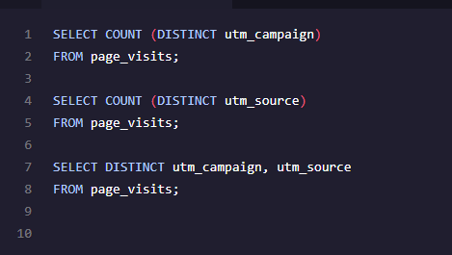
1.1 Get Familiar with CoolTShirts
1. How many campaigns and sources does CoolTShirts use? Which source is used for each campaign?
A campaign identifies the specific ad or email blast (e.g. retargetting-ad or weekly-newsletter.
A source identifies which touchpoint sent the traffic (e.g. google, email, or Facebook.
For example, the customer receives a weekly newsletter (campaign) in their email inbox (source), which prompted them to visit the CoolTShirts website.
There were 8 unique utm campaigns used in CoolTShirts advertising strategy.
There were 6 utm sources used to promote the utm campaigns.
Relation Chart
Campaigns | Sources
utm_campaign | utm_source
getting-to-know-cool-tshirts | nytimes
weekly-newsletter | email
ten-crazy-cool-tshirts-facts | buzzfeed
retargetting-campaign | email
retargetting-ad | facebook
interview-with-cool-tshirts-founder | medium
paid-search | google
cool-tshirts-search | google
Campaigns
getting-to-know-cool-tshirts
weekly-newsletter
ten-crazy-cool-tshirts-facts
retargetting-campaign
retargetting-ad
interview-with-cool-tshirts-founder
paid-search
cool-tshirts-search
Sources
nytimes
email
buzzfeed
facebook
medium
google

Slide 4
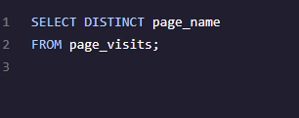
1.2 Get Familiar with CoolTShirts
2. What pages are on the CoolTShirts website?
Pages found on the CoolTShirt website are the primary pages/stages of the basic customer funnel. If a customer completes all 4 for these stages, they will have successfully purchased an item.
The campaigns must be administered to drive consumers to these four landing pages, which lead customers to completing a purchase.
Page Names
1 - landing_page
2 - shopping_cart
3 - checkout
4 - purchase

Slide 5
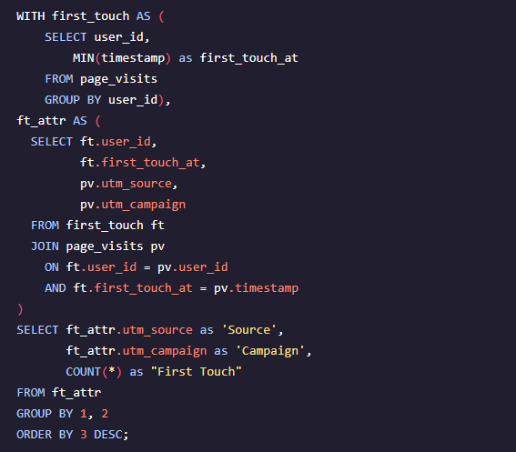
2.1 What is the user journey?
How many first touches are each campaign responsible for?
There were a total of 1,979 first touches. The “Interview with CoolTShirt’s Founder” garnered the most first touches (622 first touches). The “Cool TShirt Search” campaign received 169 first touches, which gave it an average 22.0% decrease amongst the top 3 campaigns. Whereas, the remaining 4 out of 8 campaigns were not utilized in the first touch phase of the user’s journey.
The Medium and Nytimes made up 62.3% of all first touches. The campaigns that peaked the customers interest the most seem to be centered around gaining more knowledge about the company itself.
# of First Touches by Campaign
Source | Campaign | First Touch | %
Medium | interview-with-cool-tshirts-founder | 622 | 31.4%
Nytimes | getting-to-know-cool-tshirts | 612 | 30.9%
Buzzfeed | ten-crazy-cool-tshirts-facts | 576 | 29.1%
Google | cool-tshirts-search | 169 | 8.5%
Total |  | 1,979 | 100.0%

Slide 6
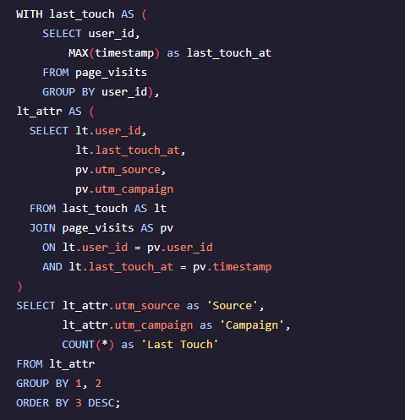
2.2 What is the user journey?
2. How many last touches is each campaign responsible for?
The weekly newsletter and the retargeting ad made up 45.0% of the last touches.
With 45.0% of last touches coming from “reminder” type advertising (weekly emails to retargeting), it shows that this particular type of marketing is valuable as it peaks the consumers enough to revisit the website.
# of Last Touches per Campaign
Source | Campaign | Last Touch | %
Email | weekly-newsletter | 447 | 22.6%
Facebook | retargetting-ad | 443 | 22.4%
Email | retargetting-campaign | 245 | 12.4%
Nytimes | getting-to-know-cool-tshirts | 232 | 11.7%
Buzzfeed | ten-crazy-cool-tshirts-facts | 190 | 9.6%
Medium | interview-with-cool-tshirts-founder | 184 | 9.3%
Google | paid-search | 178 | 9.0%
Google | cool-tshirts-search | 60 | 3.0%
Total |  | 1,979 | 100.0%

Slide 7
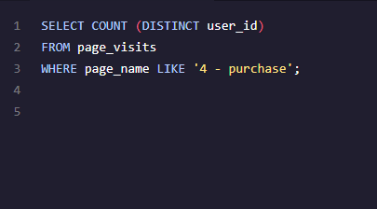
2.3 What is the user journey?
3. How many visitors made a purchase?
Three hundred and sixty-one users made a purchase, but only 18.2% of the overall users that visited the website made a purchase.
Similar to the last touch chart, over 60% of the visits who made purchases came through the weekly newsletter (email) and the retargeting ad.
361CoolTShirt purchases

Slide 8
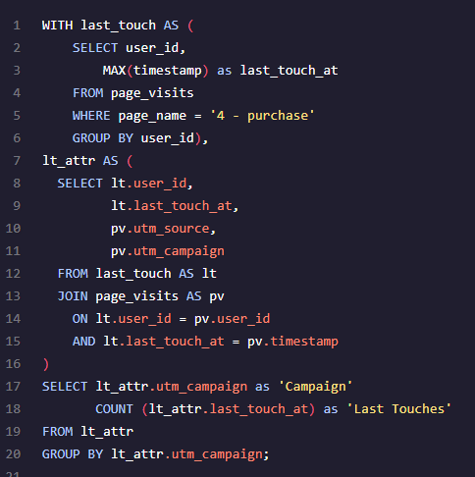
2.4 - What is the user journey?
3. How many last touches on the purchase page is each campaign responsible for?
# of Purchases by Campaign
Source | Campaign | # of Purchases | %
Buzzfeed | ten-crazy-cool-tshirts-facts | 9 | 2.5%
Email | retargetting-campaign | 54 | 15.0%
Email | weekly-newsletter | 115 | 31.9%
Facebook | retargetting-ad | 113 | 31.3%
Google | cool-tshirts-search | 2 | 0.6%
Google | paid-search | 52 | 14.4%
Medium | interview-with-cool-tshirts-founder | 7 | 1.9%
Nytimes | getting-to-know-cool-tshirts | 9 | 2.5%
Total |  | 361 | 100.0%
46.8% of visitors that purchases came through emails and 31.3% came through Facebook.
7.5% of purchases came through media outlets and Google.

Slide 9
2.5 What is the user journey?
3. What is the typical user Journey?
91.5 % of users came to the CoolTShirts website through a media outlet (Medium, Nytimes, Buzzfeed).
They were attracted by articles (campaigns) that gave them more information on the company, as 62.4% of first touch came through 2 campaigns, “Interview with Cool TShirts Founder” and “Getting to Know Cool TShirts”.
57.4% of last touches came through retargeting campaigns and newsletters.
78.1% of the 361 sales came through the retargeting ads.
Roughly 18% of all vistors made a purchase.
Based on the data provided, the average user’s journey is below.
SOURCE
Medium or NY Times
First Touch Campaign
Interview with CoolTShirts
Founder or Getting to Know Cool Shirts
Last Touch Campaign
Visitors came back through retargeting ads or Weekly Newsletters
Purchases
18% of customers Purchased something from the CoolTshirts site.
Revists
Continuous revisits through successful analysis of correct campaigns in relation to sources
In 2017, Cotton Tshirts accounted for $27.8 billion in international sales. (Field Listings Exports-Commodities, WFB(CIA)

Slide 10
3. Which campaigns should CoolTShirts re-invest in?
I would recommend investing in the following 6 campaigns, Interview with CoolTShirts Founder, Getting to Know CoolTShirts, Ten Crazy CoolTshirt Facts, Weekly Newsletter, and Retargetting-Ads. We see that the campaigns that focused on the information about the actual company tends to get the customers in the door, but reminder based advertisings helped to facilitate purchases.
Since we spotted the importance of reminder based advertising, we would most likely want to run some of the popular first touch campaigns through the following sources (Buzzfeed, Nytimes, Medium).
Most of the retargeting campaigns are through emails and Facebook. Since these sources did not introduce traffic to the site, we can run the company based emails through social media/emails to capture the attention of our audience.
Reminders seem to be a big hit when it comes to purchasing. To capture more first time users, immediately upon entrance of the website, we could display a “CoolTShirts Newsletter” pop up. The pop up can include 5-10% discount on their first purchase to get them to sign up before browsing. We then have a connection to the customer, can retarget more consumer sthrough weekly newsletters.
CoolTShirts should continue running ads on media sites that get the brands name out to the public.
Paid search on Google scored pretty low across the board. CoolTShirts should consider cutting this from the marketing budget.

